Slide 1



UNIVERSITY OF PRETORIA
ERP 420
Practical 2 and 3:
Queuing Management Systems
Jaco Marais
Adapted By: Llewellyn Strydom

Slide 2
Practical Objectives
Extend simulator from Practical 1
  Report
Develop and analyse a queuing scenario.
Propose a queuing management system (QMS).
  Presentation
FPGA hardware implementation.
Evaluate quality of service (QoS).
  Demo + report
Practical 2
Practical 3

Slide 3
Part A - Priority Queuing
Take M/M/1 simulator and add priority queuing
Preemptive priority
  running task is interrupted and resumed later
Non-preemptive priority
  a running task is executed till completion.
Compare the performance between no priorities, pre-emptive and non-preemtive
Vary the arrival rates for priority and non-priority packets

Slide 4
Part B - QMS
Queuing system requirements and classification
  Proposed scenario and model
QMS design factors and bounds/restrictions
  Real world scenario
QMS implementation on FPGA
Quality of service (QoS)
  Qualities
  Mechanisms
Justification and evaluation of implemented QMS

Slide 5
Queuing Scenario (Examples)
Doctor’s office
Bank
Fast food outlet / Restaurant
Amusement park
Call centre
Transportation depo
Supermarket / Grocery store
Toll gates
Hospital
Hair dresser
Manufacturing process
Etc.

Slide 6
Queuing Management System
What is a QMS used for?
Customer flow management aimed at efficiency
Controls:
  The way customers join queue
  How customers already in queue are selected for servicing
Implemented where customers have to wait to be serviced
Dependant on application, resources, special conditions, etc.
Various means of implementation
  Mechanical, electronic and computerized

Slide 7
Queuing Management System
Queuing Discipline and Scheduling
Determines how the server handles customers.
  The way they will be served
  Order in which they are served
  How resources are shared between customers
Service Disciplines:
  FIFO
  LIFO
  Shortest job first
  Most profitable job first
  Etc.

Slide 8
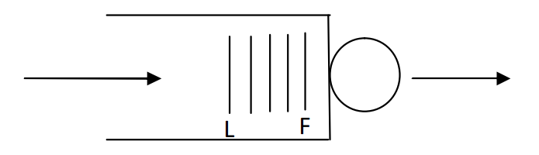
Queuing Management System
Queuing Discipline and Scheduling
FIFO (First in first out):
  Ordinary queue
  Served one at a time
  According to arrival

Slide 9
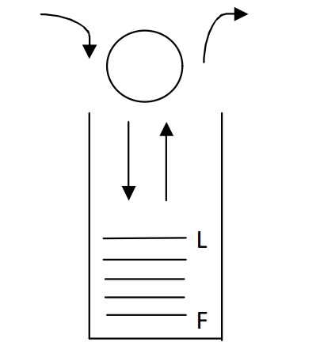
Queuing Management System
Queuing Discipline and Scheduling
LIFO (Last in first out):
  Stack
  Served one at a time
  Shortest waiting time served first

Slide 10
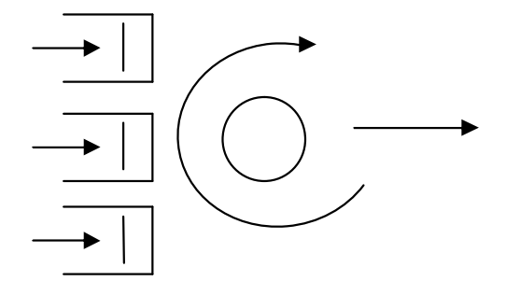
Queuing Management System
Queuing Scheduling
Capacity Sharing / Processor Sharing:
  Equally served
  Network capacity shared
  Experience same amount of delay
  Serviced simultaneously

Slide 11
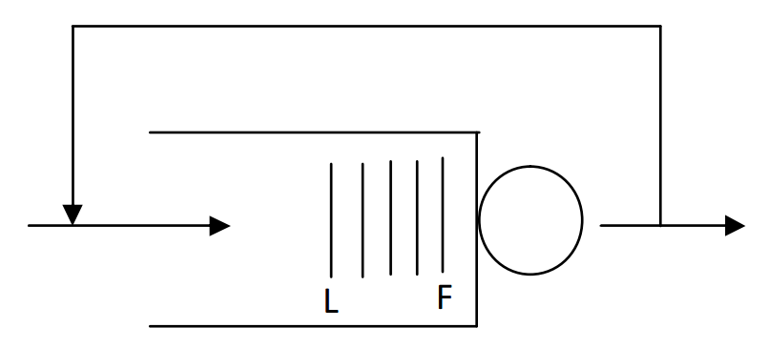
Queuing Management System
Queuing Scheduling
Service in rotating order:
  Round Robin (RR)
  Everyone gets a turn (time slice)

Slide 12
Queuing Management System
Queuing Discipline and Scheduling
Other:
  Priority
  Service in random order (SIRO)
  Shortest job first (SSF)
    Minimizes mean waiting time

Slide 13
Queuing Management System
System Requirements and Classification
Restaurant example:
  How do customers arrive in the restaurant? Are customer arrivals more during lunch, dinner time
  (a regular restaurant)? Or is the customer traffic more uniformly distributed (a café)?
  How much time do customers spend in the restaurant? Do customers typically leave the restaurant
  after a fixed amount of time? Does the customer service vary with the type of customer?
  How many tables does the restaurant have for serving customers?

Slide 14
Queuing Management System
System Requirements and Classification
Arrival process
Service process
Number of servers
A/S/n models

Slide 15
Queuing Management System
Design Factors
Arrival process
  Inter-arrival times
  Group arrivals
Service process
  Service times
Number of servers
Number of queues
Number of waiting places (queuing areas)

Slide 16
Queuing Management System
Design Factors
Service disciplines
  FIFO
  LIFO
  Shortest job first
  Most profitable job first.
  -Round robin
  Processor sharing
  Priorities

Slide 17
Queuing Management System
Design Factors
7 Information available
  Upon choice of queue does the customer know length of queue and service time?
8 Discrete time / Continuous time
9 Other factors
  Faults / malfunctions
  Strikes
  Real life events

Slide 18
Queuing Management System
Design Parameters
Service discipline
Peak time
Peak days / months / year (time base)
Queuing area
Average service time

Slide 19
Queuing Management System
Design Parameters
Average waiting time
Average time between arrivals (inter-arrival time)
Arrival rate
Service rate
Mean time for customers to wait and be served (response time)
Efficiency (performance factor)

Slide 20
Queuing Management System
Quality of Service (QoS)
Measure of performance
  Error rates
  Throughput
  Transmission delay
  Availability
  Etc.
Mechanism
  Compensate or correct issues in system

Slide 21
Proposal presentation
Scenario
Formulation of problem statement
Motivation
Objectives
Approach
  Design Factors
  Parameters
  Model
Deliverables

Slide 22
Demonstration
FPGA Implementation:
  Own intuition
  Make it practical
  Used to explain chosen scenario and model (easily)
  Utilize inputs and outputs
  Ensure step by step operations can be observed

Slide 23
Submission and Deadlines
Prac 2 Report
  20 September 2019
Prac 2 Presentation
  20 September 2019
Prac 3 Report
  18 October 2019
Prac 3 Demonstration
  18 October 2019

Slide 24
Additional Information
Submit softcopies via ClickUP and the EPS
Complexity of proposed system
Demonstration in NetLab A
  Online bookings
Presentations in multiple venues
  Online bookings
Lab book

Slide 25



Questions?

